Slide 1



SQL SUB LANGUAGES
Sai Vardhan T

Slide 2
INTRODUCTION TO SQL SUB LANGUAGES
SQL itself encompasses various functionalities categorized into sub-languages, each serving specific purposes in database management.
DATA DEFINITION LANGUAGE (DDL)
DATA MANIPULATION LANGUAGE (DML)
DATA QUERY LANGUAGE (DQL)
DATA CONTROL LANGUAGE (DCL)
TRANSACTION CONTROL LANGUAGE (TCL)

Slide 3
DATA DEFINITION LANGUAGE
Focuses on defining the structure of your database.
Key functionalities include:
CREATE: Used to create database objects like tables, views, indexes, etc. (e.g., CREATE TABLE customers (id INT PRIMARY KEY, name VARCHAR(255), email VARCHAR(255)))
ALTER: Allows modifying the structure of existing database objects. (e.g., adding a new column to a table)
DROP: Used to remove database objects when they are no longer needed. (e.g., DROP TABLE customers)

Slide 4
DATA MANIPULATION LANGUAGE
Deals with inserting, updating, and deleting data within the database.
Key functionalities include:
INSERT: Adds new data records to a table. (e.g., INSERT INTO customers (name, email) VALUES ('John Doe', 'john.doe@example.com'))
UPDATE: Modifies existing data in a table based on specific criteria. (e.g., UPDATE customers SET email = 'new_email@example.com' WHERE id = 1)
DELETE: Removes data records from a table based on conditions. (e.g., DELETE FROM customers WHERE id = 1)

Slide 5
DATA QUERY LANGUAGE
Primarily used for retrieving data from the database.
Key functionality:
SELECT: Forms the core of data retrieval. Allows you to specify which data to extract from tables, applying filters and sorting as needed. (e.g., SELECT * FROM customers WHERE city = 'New York' ORDER BY name ASC)

Slide 6
DATA CONTROL LANGUAGE
Manages user access privileges and permissions within the database.
Key functionalities include:
GRANT: Assigns specific permissions to users for data access or manipulation (e.g., allowing a user to select data from a table).
REVOKE: Takes away previously granted permissions from users.

Slide 7
TRANSACTION CONTROL LANGUAGE
Deals with managing database transactions, which are sets of database operations treated as a single unit.
Key functionalities include:
COMMIT: Makes the changes from a transaction permanent in the database.
ROLLBACK: Undoes the changes from a transaction if something goes wrong, reverting to the state before the transaction begins.
Sometimes considered as DML

Slide 8
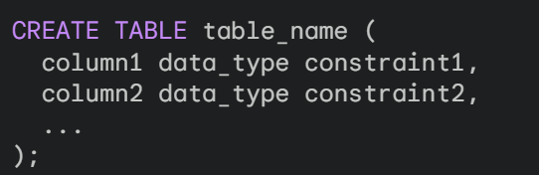
DDL - CREATING TABLES
You can create a table in MySQL using the CREATE TABLE statement within the Data Definition Language (DDL) sub-language of SQL
SYNTAX:

Slide 9
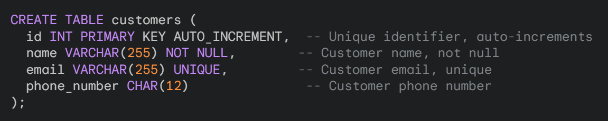
EXAMPLE FOR CREATION OF TABLE

Slide 10
NULL & NOT NULL
NULL Values:
In databases, a NULL value represents the absence of a known data value. It's often used to indicate that a data point is missing or unknown.
NOT NULL Constraint:
The NOT NULL constraint is a data integrity rule enforced at the column level in a table. It ensures that a column cannot contain NULL values. This means every record in that column must have a valid data entry.

Slide 11
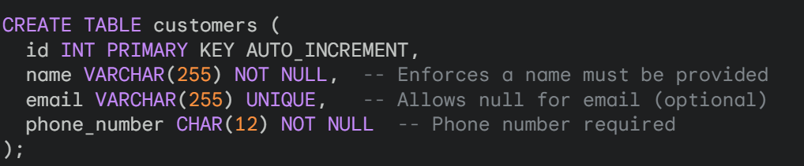
EXAMPLE FOR NULL & NOT NULL (1)
name and phone_number have NOT NULL constraints, so every customer must have a name and phone number.
email allows NULL values, indicating it's optional.

Slide 12
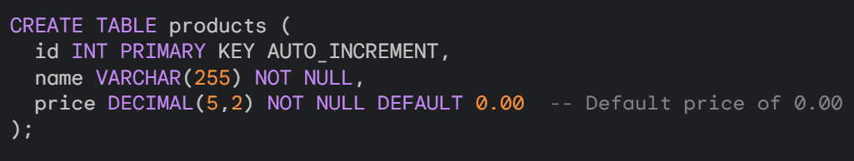
EXAMPLE FOR NULL & NOT NULL (2)
You can also define a default value to be inserted automatically if no value is provided during data insertion, even with a NOT NULL constraint.
Here, the price column has a NOT NULL constraint but also sets a default value of 0.00 if no price is provided during insertion.

Slide 13
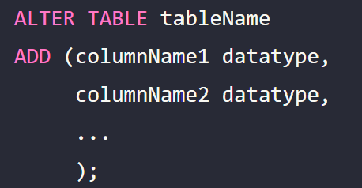
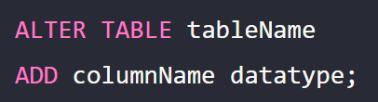
DDL - ALTER
ADD COLUMN:
ADD SINGLE COLUMN
ADD MULTIPLE COLUMN

Slide 14
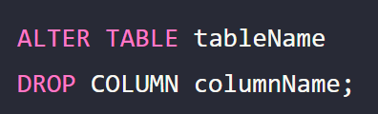
DDL - ALTER
DROP COLUMN

Slide 15
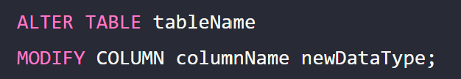
DDL - ALTER
MODIFY DATA TYPE

Slide 16
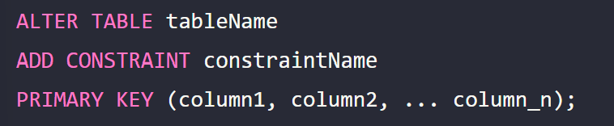
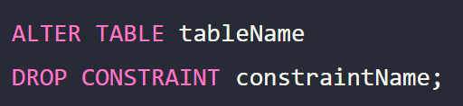
DDL - ALTER
ADD CONSTRAINTS
DROP CONSTRAINTS

Slide 17
DDL - DROP
The DROP statement falls under Data Definition Language (DDL) in MySQL. It's a powerful tool for removing database objects like tables, indexes, views, and even entire databases.
THREE FUNCTIONALITIES
Dropping a Table
Dropping an Index
Dropping a view

Slide 18


DESCRIBING STRUCTURE
Once you've created a table, you can use the DESCRIBE statement to view its structure, including details about each column.
SYNTAX:
EXAMPLE:

Slide 19
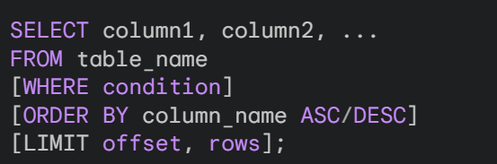
DQL - SELECT
The SELECT statement is the foundation for retrieving data from tables in MySQL. It forms the core of the Data Query Language (DQL) sub-language.

Slide 20

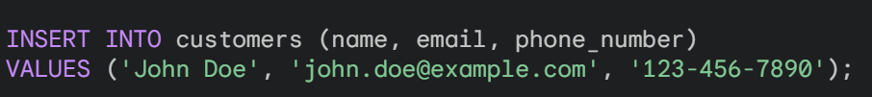
DML - INSERTION
INSERT WITH VALUES CLAUSE(SINGLE ROW):
SYNTAX:
EXAMPLE:

Slide 21
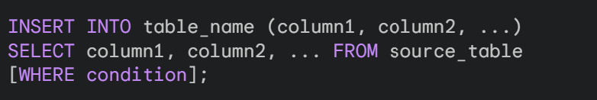
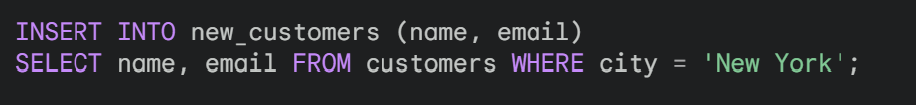
DML - INSERTION
INSERT WITH SELECT (INSERTING FROM ANOTHER TABLE):
SYNTAX:
EXAMPLE:

Slide 22
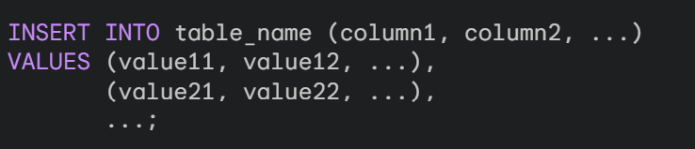
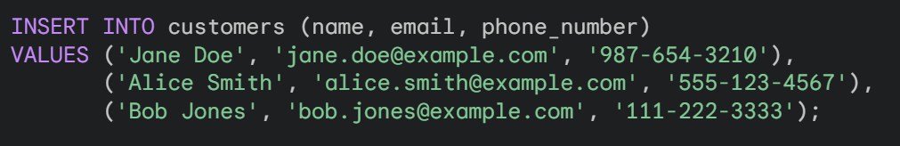
DML - INSERTION
INSERT Multiple Rows with VALUES Clause:
SYNTAX:
EXAMPLE:

Slide 23

DML - INSERTION
INSERT with SELECT for Multiple Rows:
Similar to single-row insertion with SELECT, you can use SELECT to retrieve data from another table and insert multiple rows at once.
SYNTAX:

Slide 24
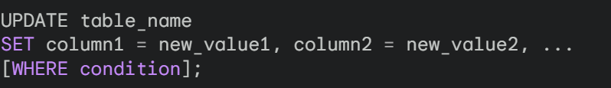
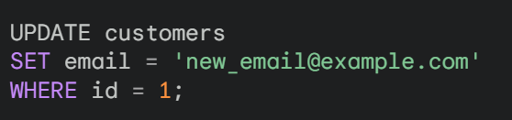
DML - UPDATE
The UPDATE statement allows you to modify existing data within a table in MySQL. It forms a core part of Data Manipulation Language (DML)
SYNTAX:
EXAMPLE:

Slide 25


DML - DELETE
The DELETE statement is another crucial part of Data Manipulation Language (DML) in MySQL. It allows you to remove rows permanently from a table.
SYNTAX:
EXAMPLE:

Slide 26


Dropping a Table (Object)
SYNTAX:
EXAMPLE:

Slide 27


DROPPING AN INDEX
SYNTAX:
EXAMPLE:

Slide 28


DROPPING A VIEW
SYNTAX:
EXAMPLE:

Slide 29
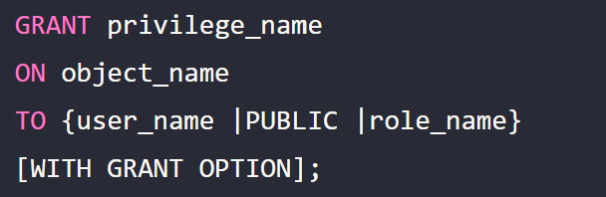

DCL - GRANT
The GRANT statement allows database administrators to grant permissions or privileges on a database object to users.
There are various types of privileges like SELECT, INSERT, UPDATE, DELETE, REFERENCES, ALL.
SYNTAX:
EXAMPLE:
In this example, user1 is granted permission to read/perform SELECT operations on the employees table.

Slide 30
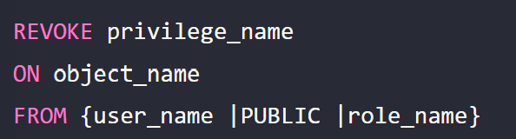
DCL - REVOKE
The REVOKE statement can be used when we want to revoke some or all of the privileges that were assigned earlier to a user or a group of users.
The syntax for using the REVOKE command is similar to the GRANT command.
SYNTAX:
EXAMPLE:
In this example, user1 is revoked from the permission to read/perform SELECT operations on the employees table.

Slide 31

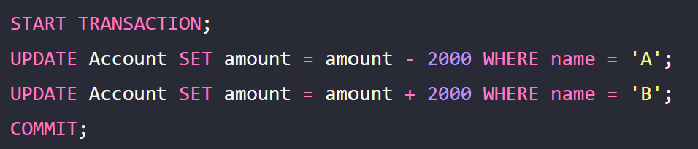
TCL - COMMIT
SYNTAX:
EXAMPLE:
In this transaction, $2000 is transferred from account ‘A’ to account ‘B’. The COMMIT statement makes these changes permanent in the database.

Slide 32

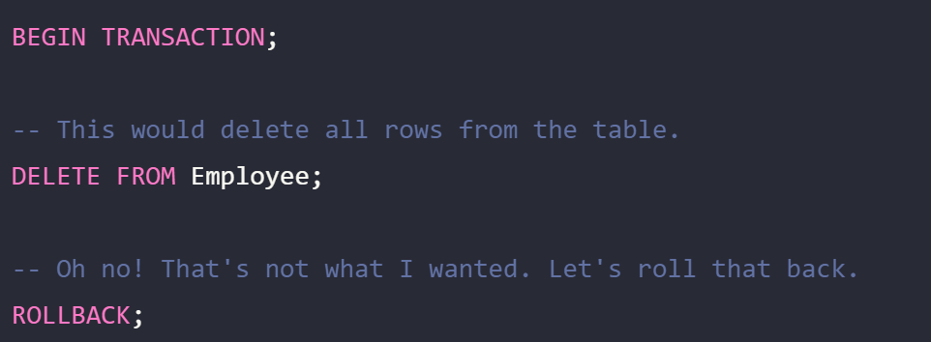
TCL - ROLLBACK
SYNTAX:
EXAMPLE:

Slide 33

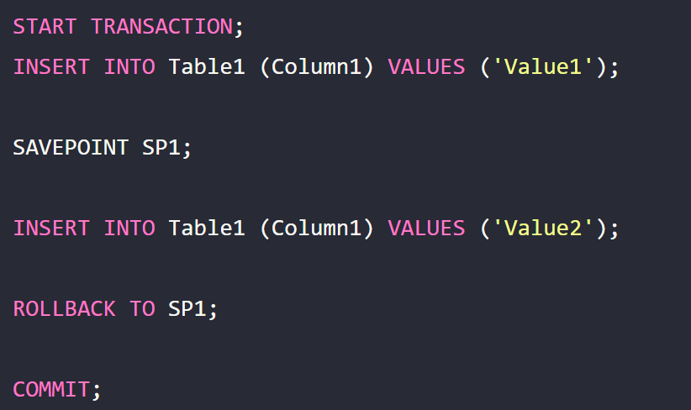
TCL – SAVE POINT
SYNTAX:
EXAMPLE:

